Slide 1
RootsFinder:
A Free New Family Tree

Slide 2

is a free new family tree that makes family history easy to research and easy to share

Slide 3
Easy to Research
Hints
Evidence-based Research
Web-clipper
FamilySearch Integration
Evidence Analysis Tools

Slide 4
Easy to Share
Invite others to view or edit your tree
Pinterest-like Media Wall
Videos with narration and/or music
Dashboard
Social media sharing

Slide 5
Auto-hints from our partners
FamilySearch
Findmypast
Newspaper Archives
Linkpendium
More coming soon!

Slide 6
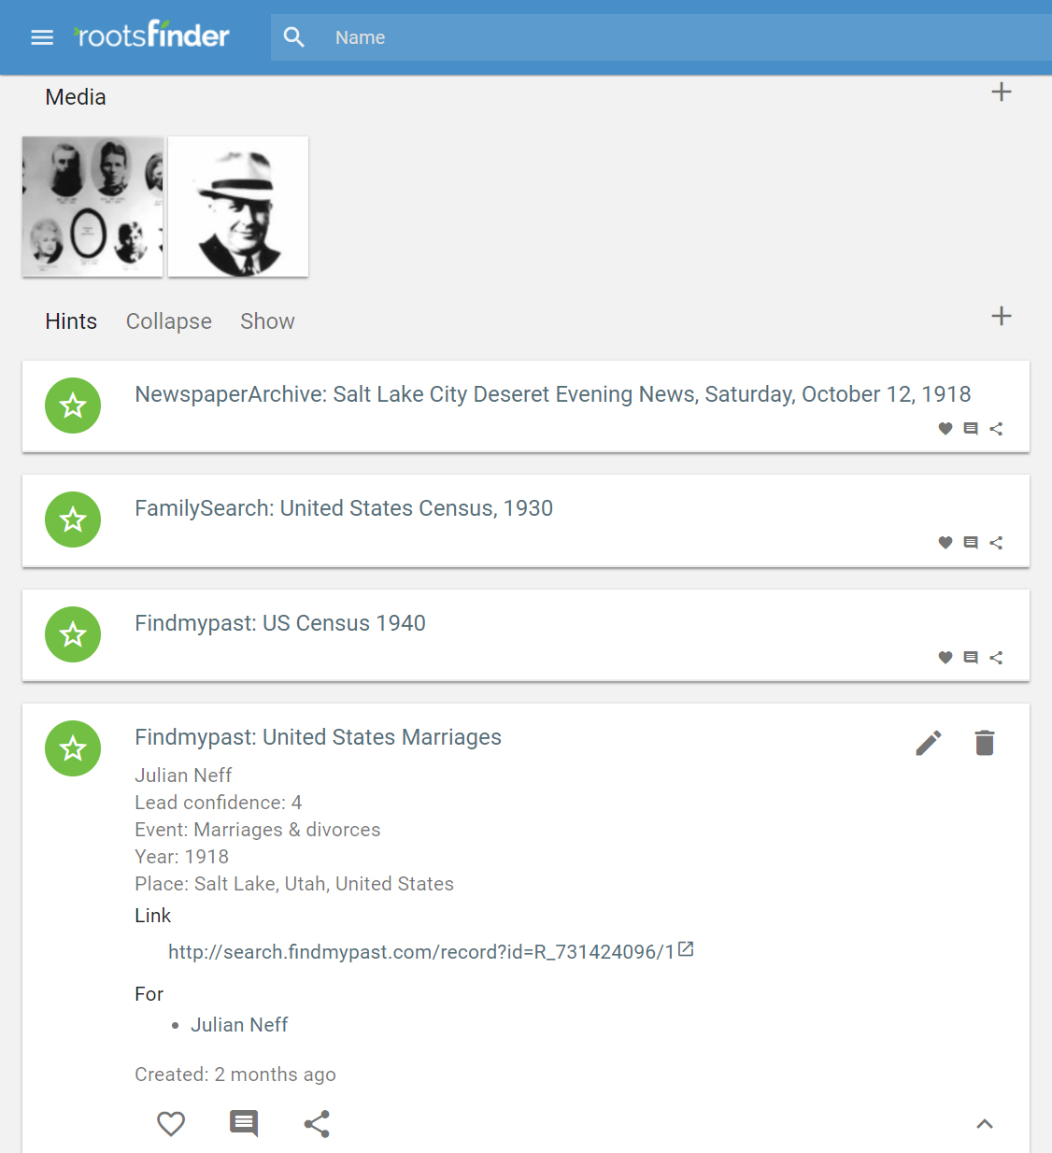
Click any hint to see details, including:
Confidence level
Event details
Link to partner site

Slide 7
Evidence-based Research
Gather & display all information from a source at once
  Source citations
  Event data
  Relationships

Slide 8
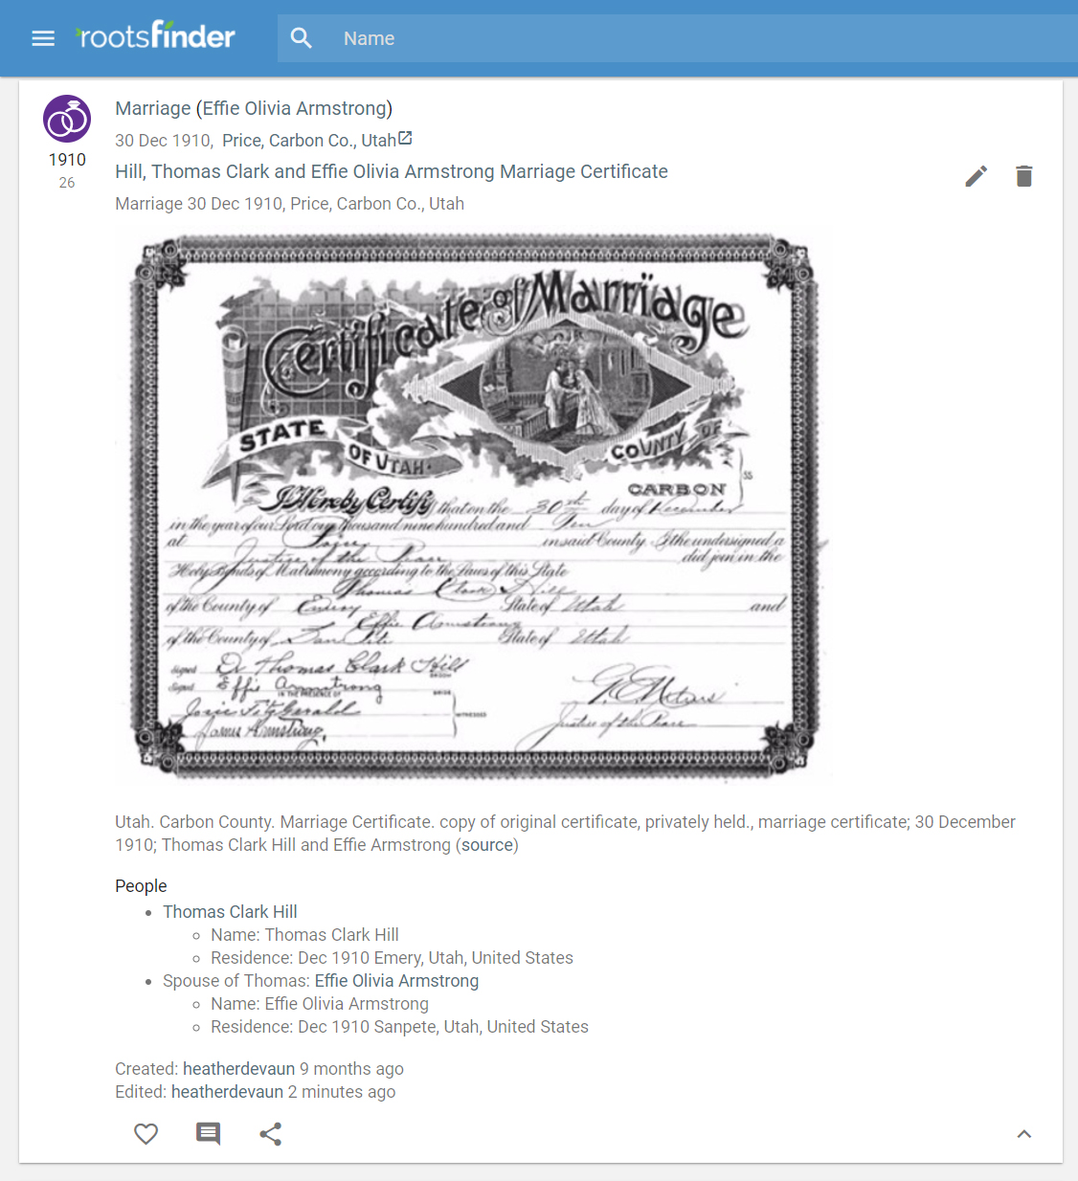
Instantly see all the evidence about all people involved in an event.

Slide 9
Web Clipper
Install the web clipper for Chrome
Automatically copy information into your tree
Use on major genealogy websites such as FamilySearch, Ancestry, Find A Grave, American Ancestors, etc.

Slide 10
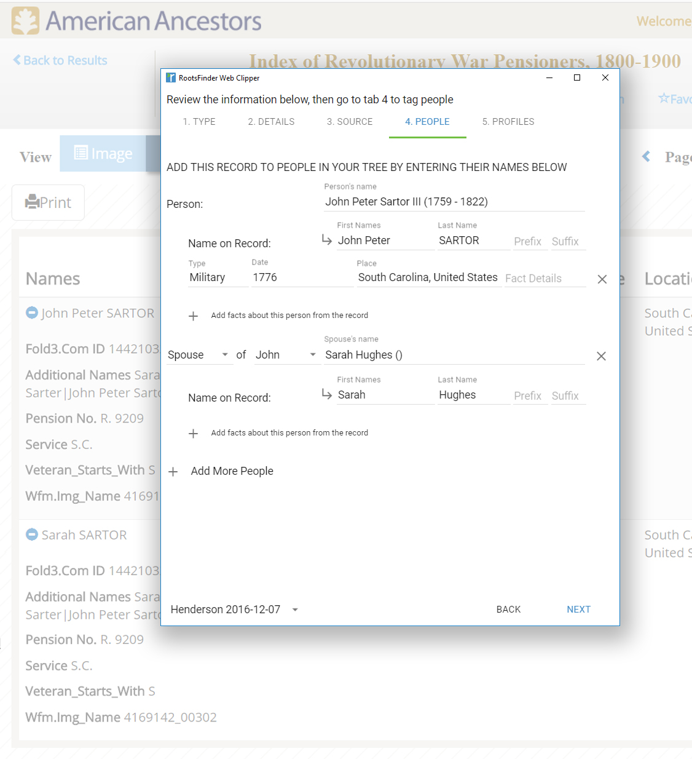
Events are automatically processed by the clipper; you just tag people in your tree to attach.

Slide 11

FamilySearch Integration
Download your
FamilySearch tree
Sync people to share data, documents, sources, and photos back and forth

Slide 12
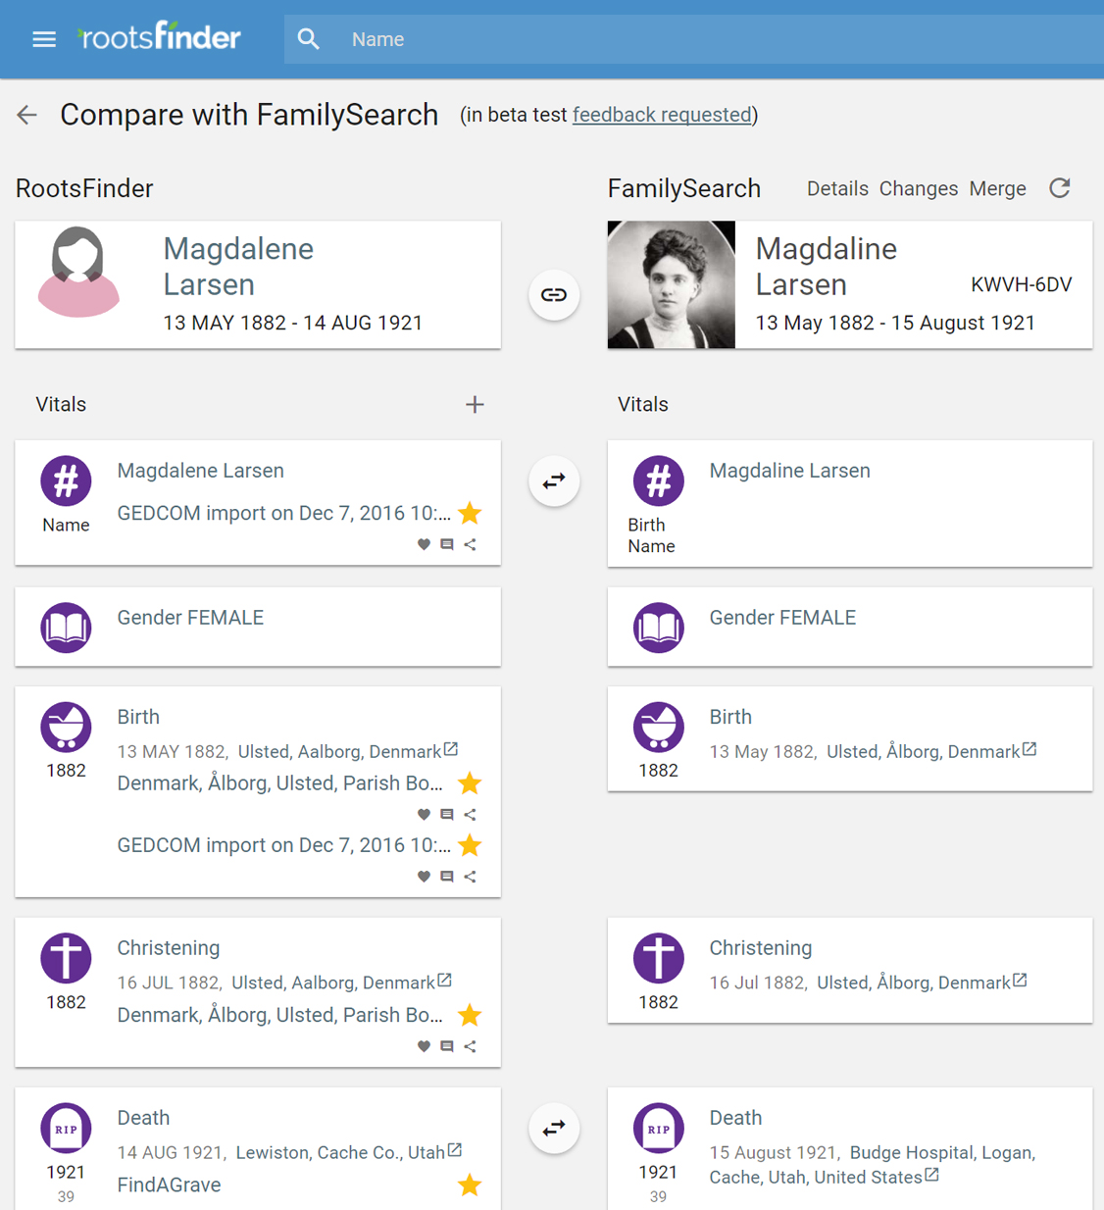
Import your tree (with sources and media attached!) from FamilySearch, then compare changes to stay up to date.

Slide 13
Evidence Analysis Tools
Evidence analysis report puts information from sources side-by-side to see how they compare

Slide 14
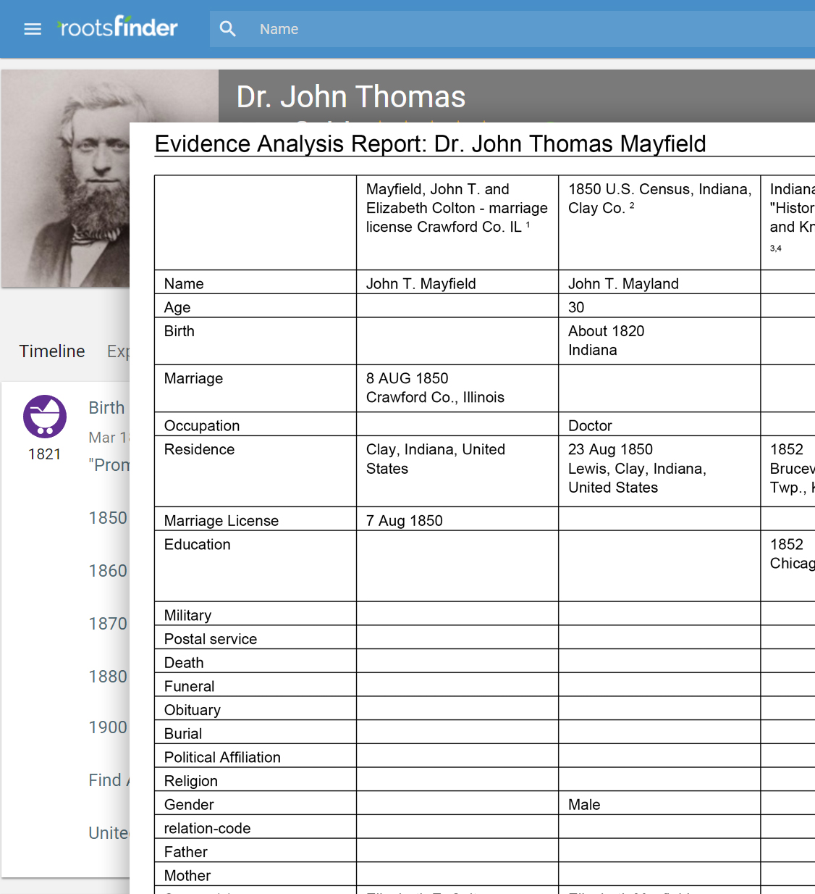
The evidence analysis report puts information side by side to show how sources changed over time.

Slide 15
Invite others to your tree
You control your tree
  Invite for read-only
  Or allow editing
See what your guests have done

Slide 16
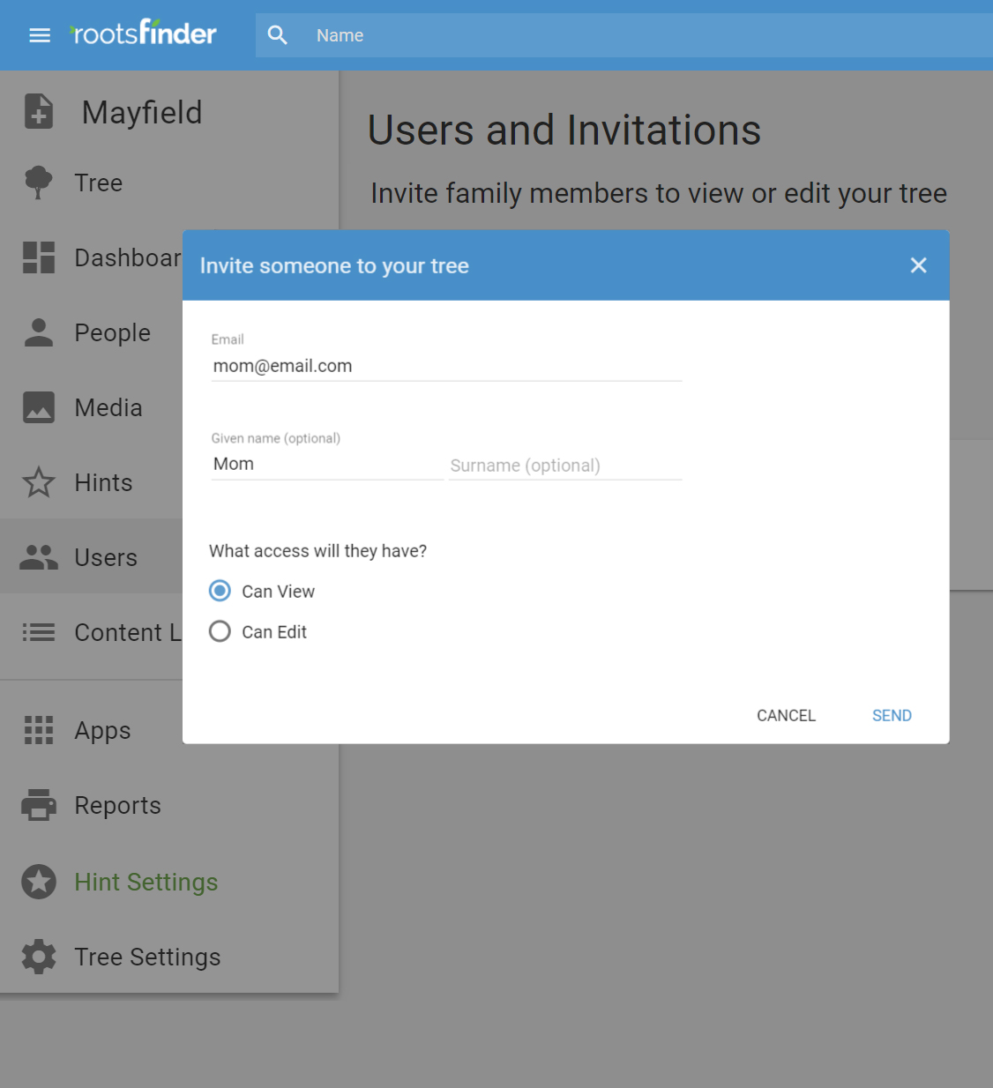
Assign access privileges when you invite people to your tree. You can change it later if needed.

Slide 17
Pinterest-like Media Wall
Pinterest-like Media Wall shows all images in your tree
  No need to “walk the tree” to find interesting items
  Post/share on social media

Slide 18
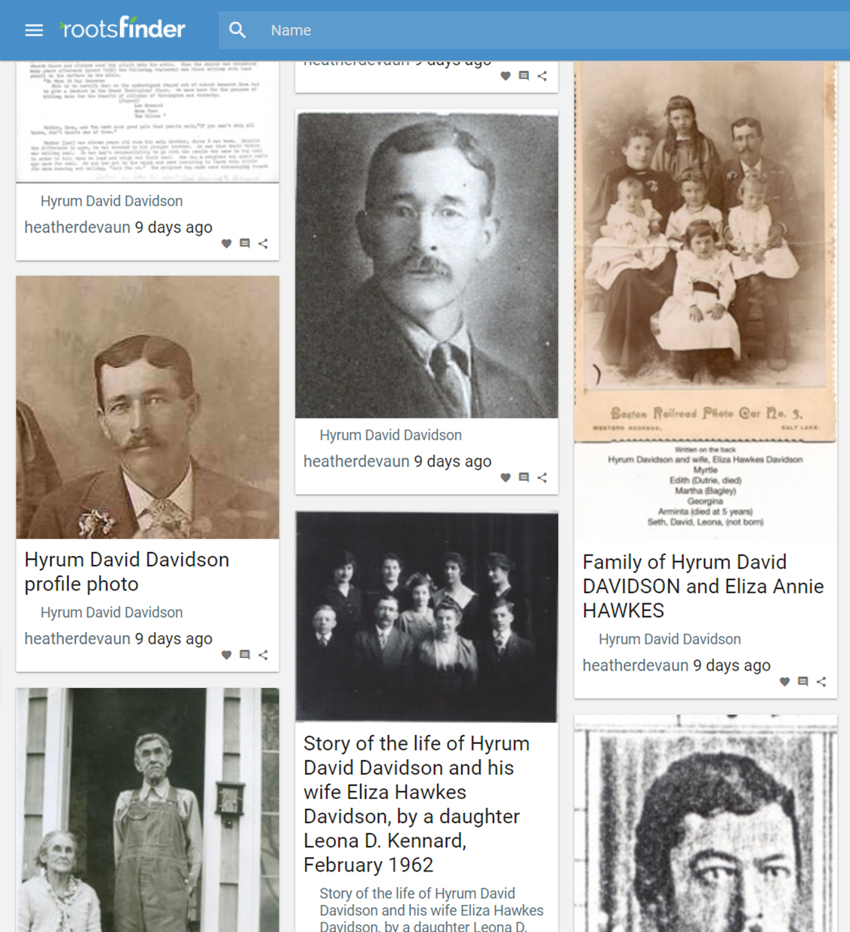
The media wall helps you find interesting photos and stories in your tree.

Slide 19
Make videos
Create videos using your photos
Add music
Add narration (if you want)
Post to social media

Slide 20
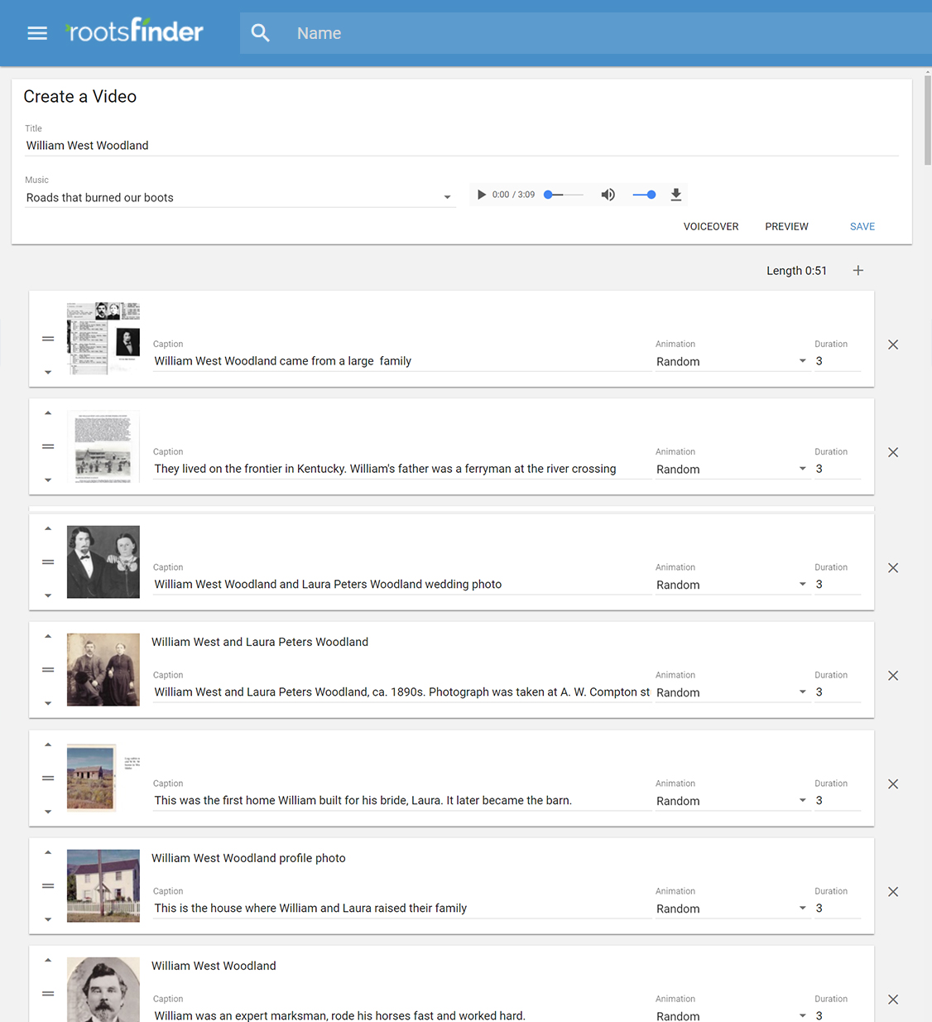
Making a video is easy. Just select photos and edit text as desired.

Slide 21
Dashboard
Show most recent changes
Add bookmarks
Statistics about your tree

Slide 22
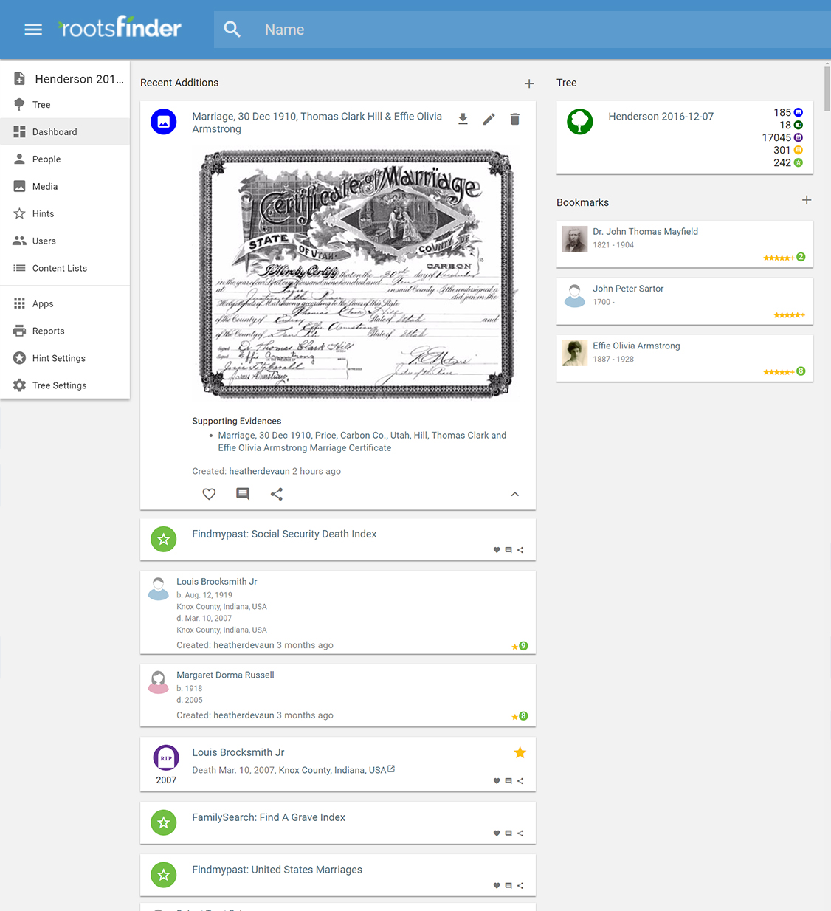
The dashboard shows new people, documents, stories, etc. added to your tree.

Slide 23
Social media sharing
Share on Facebook, Pinterest, or Twitter
  People pages
  Photos
  Stories
  Videos

Slide 24
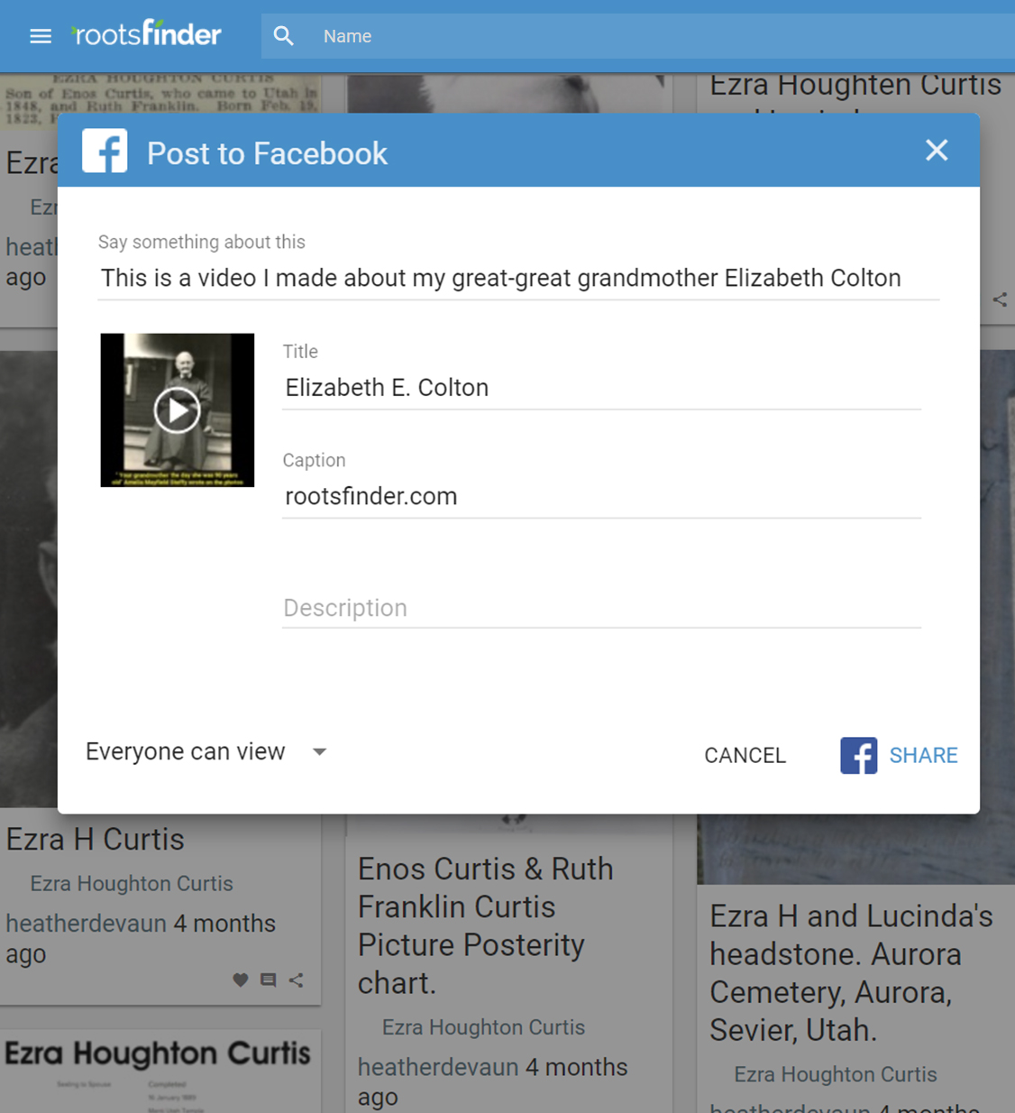
RootsFinder makes it easy to share items to social media to share with family and friends.

